Slide 1

Fruit Classification using Convolutional Neural Networks (CNN)
Russell Cachia MSD 6.3B
Notes:
Introduce title + name and class

Slide 2
Problem Definition
Aim of the study:
The goal of this study is to develop and evaluate a CNN model that can effectively classify fruit categories based on their independent visual features. Specifically, this study aims to investigate the impact of dataset choice on model performance. By addressing this, this study aims to improve the accuracy and reliability of fruit classification systems, ultimately contributing to advancements in agricultural technologies.

Slide 3
Hypothesis & Research Questions
The purpose of this research is to investigate the use of computer vision and machine learning techniques to aid in fruit classification.
To address the hypothesis, we ask these 2 research questions to identify the determining factors of Fruit Classification using CNN:
1. How does the choice of data set impact the performance of CNN models for fruit classification?
2. How much of a difference do layers create with regard to accuracy?
Notes:
1. The first research question aims to look at other studies and their use of datasets in regards to accuracy percentage 2. Regarding the second research question, aims to explore the effect of additional layers of a CNN model on accuracy. While most studies did not directly specify their model construction, it was found that the model used with 9 layers achieved high accuracy results.

Slide 4
Reviewed Methodologies
A very similar study was [6] were they achieved a 99.79% accuracy using the same Fruits360 dataset but reducing it to 18,000 images. The only downside was that their model architecture chosen was not specified in terms of layers which leads us to believes that due to the studies using a similar dataset bases, the difference in accuracy rates was due to the model architecture.
[6] S. Sakib, Z. Ashrafi, M. Siddique, and A. Bakr, “Implementation of fruits recognition classifier using convolutional neural network algorithm for observation of accuracies for various hidden layers,” 2019.

Slide 5
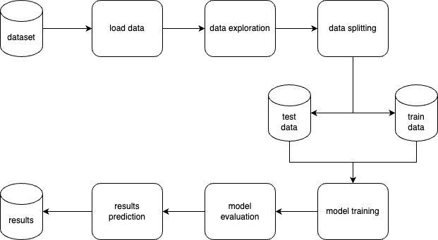
Methodology Used
The aim of this research is to investigate the effectiveness of Convolutional Neural Networks (CNNs) in fruit classification and address the challenges related to accuracy, precision, and data set size. To accomplish this, the following pipeline was set and followed:
Notes:
80/20 split, training on 80% and testing with the other 20%

Slide 6
Experiment Design
The design to this experiment was as follows:
Installation of Necessary Libraries
Exploration of Dataset
Preparation and Visualization of Data
Definition of the CNN Model
Training of Data
Model Evaluation and Graph Generation
Data Augmentation
Saving the Model
Results Prediction

Slide 7
Data Collection
As a base, the dataset used was Fruits360, which is an open source dataset and can be found from: https://www.kaggle.com/datasets/moltean/fruits
This dataset was then edited to better fit the study, and the final outcome was totalled to 58,380 images with 47 categories.

Slide 8
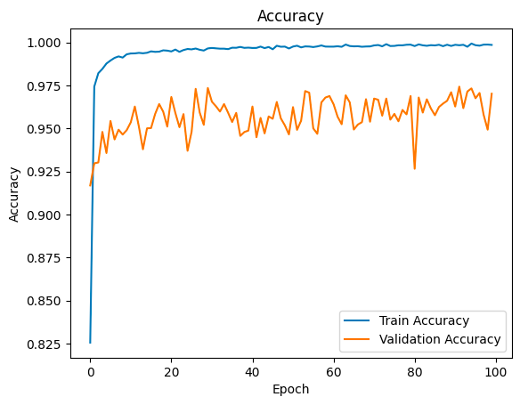
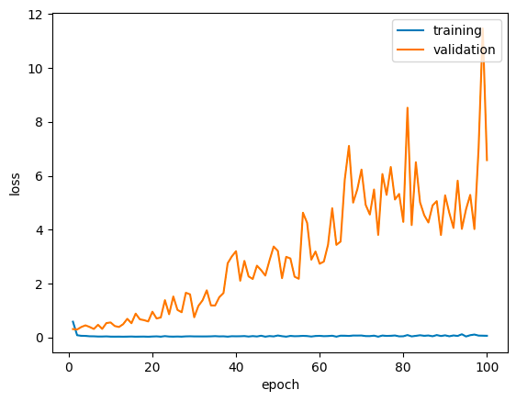
Results
Notes:
The initial loss was relatively high, which indicates discrepancy between the predicted and actual fruit labels. However, as the training progressed, the training loss steadily decreased, indicating that the model successfully learned to minimize the difference between predicted and actual labels.
The graph reveals a consistent increase in accuracy as the model learned from the training data. It started at a relatively low accuracy level and gradually improved with each epoch, eventually leading to a 98% accuracy

Slide 9
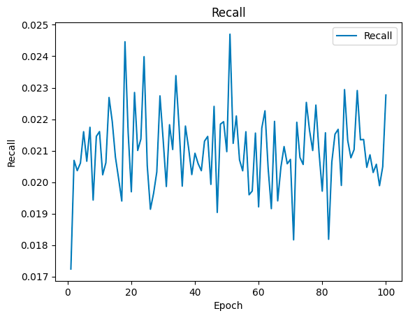
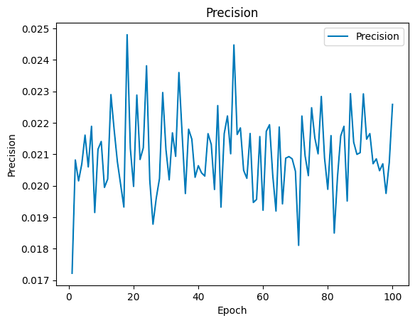
Results
Notes:
Recall and precision normaly define the ability of the model to map all of the relevant classes or categories with the dataset, and as we can see the rates where very low between a minimum of 0.017 and maximum of 0.025

Slide 10
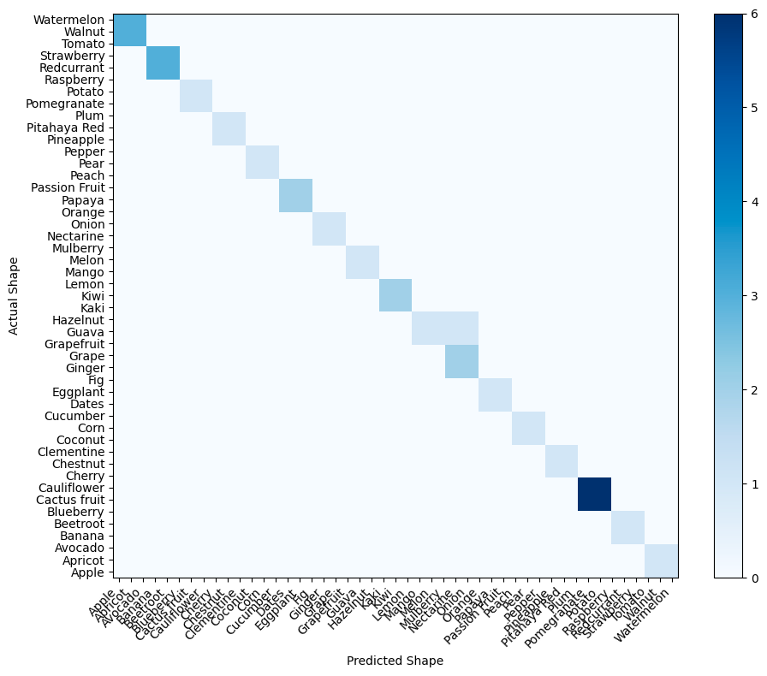
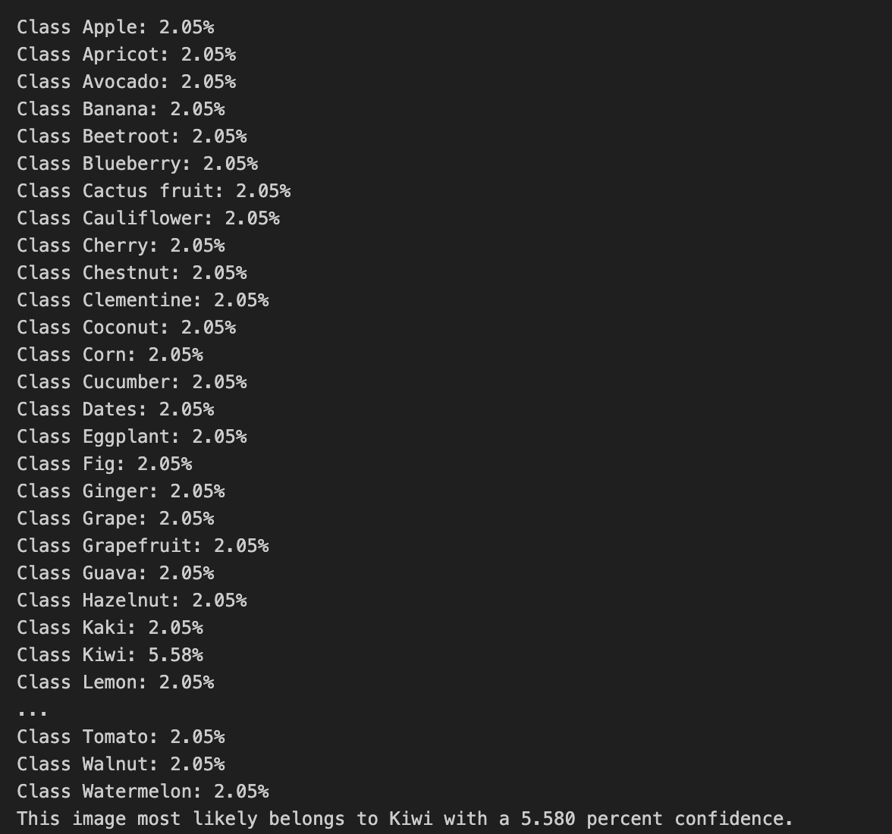
Results & Analysis
Notes:
The confusion matric shows a representation of the number of correct and incorrect predications for each fruit class while in the confidence image here we can see that the model correctly classified the fruit (kiwi)

Slide 11
Conclusions
Overall, this literature review highlights that it is crucial to carefully select representative and diverse data sets that encompass a wide range of fruit classes to improve the model's accuracy and robustness. Although being a critical step, it is not the only determining factor in terms of accuracy and precision when it comes to classify different fruits, as different layers of the CNN model also impact these metrics.

Slide 12


Future Recommendations
Explore techniques for different
Layers of CNN for better results
Larger data sets

Slide 13
Thank you Russell Cachia

